Slide 1
Chapter 6: Synchronization Tools

Slide 2

Peterson’s Solution and Modern Architecture
Software-based solutions are not guaranteed to work on modern computer architectures.
Peterson’s solution is not guaranteed to work on modern computer architectures for the primary reason that, to improve system performance, processors and/or compilers may reorder read and write operations that have no dependencies.
For a single threaded application, this reordering is immaterial as far as program correctness is concerned, as the final values are consistent with what is expected.
This is similar to balancing a checkbook—the actual order in which credit and debit operations are performed is unimportant, because the final balance will still be the same.
But for a multithreaded application with shared data, the reordering of instructions may render inconsistent or unexpected results.

Slide 3
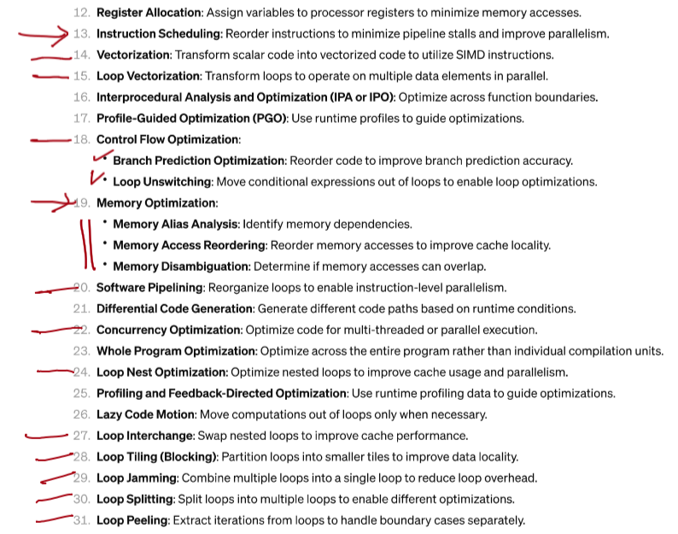

Partial List of Compiler Optimizations

Slide 4
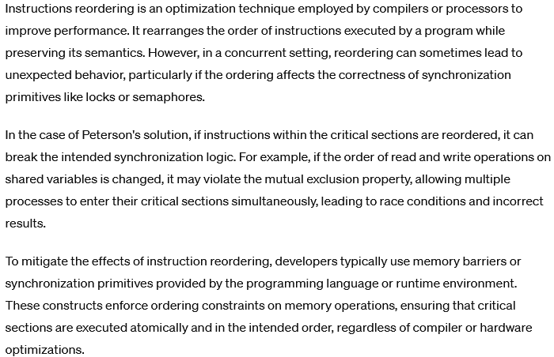
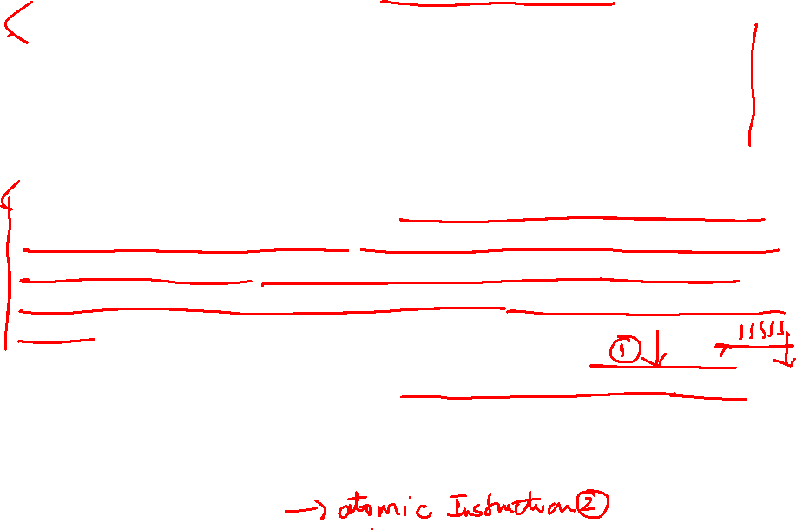
Instruction Re-ordering

Slide 5
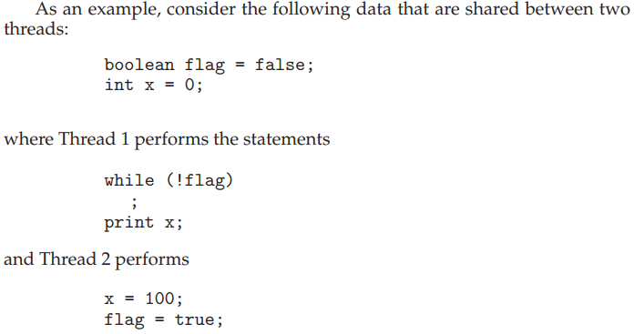
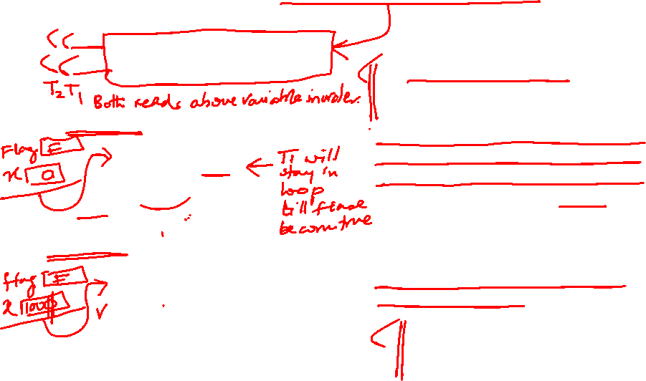
Modern Architecture Example
The expected behavior is, of course, that Thread 1 outputs the value 100 for variable x.
If due to reordering of instructions in Thread 2 so that flag is assigned true before assignment of x = 100.
Thread 1 would output 0 for variable x.
The processor may also reorder the statements issued by Thread 1 and load the variable x before loading the value of flag.
Thread 1 would output 0 for variable x even if the instructions issued by Thread 2 were not reordered.

Slide 6
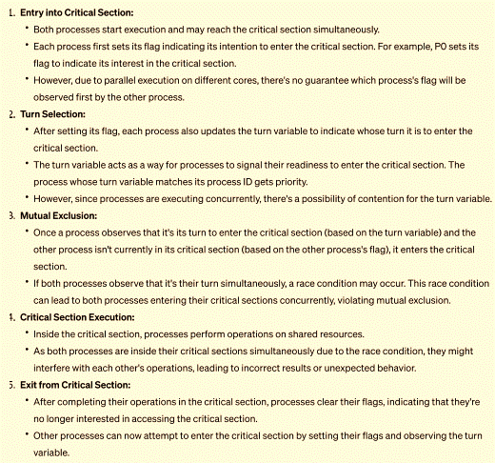
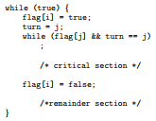
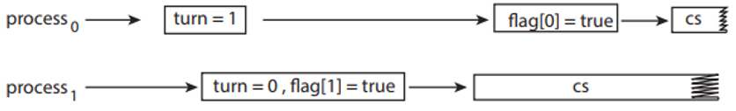
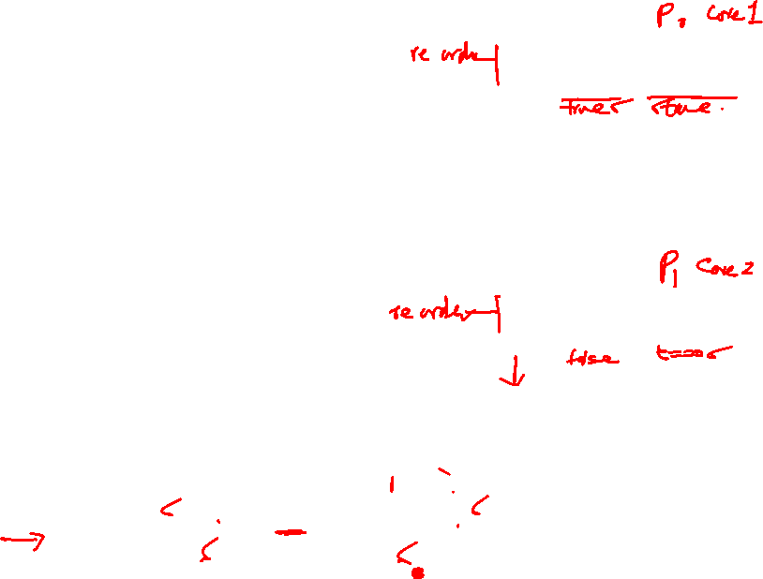
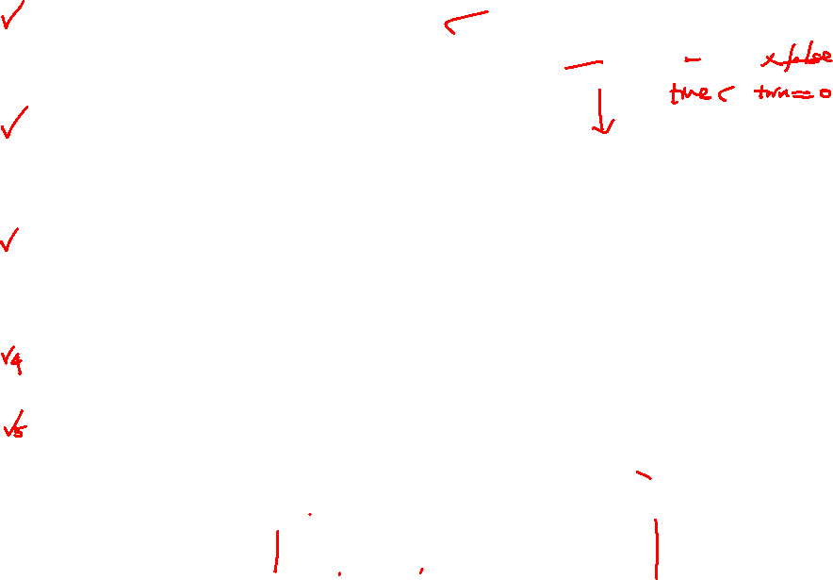
Peterson’s Solution – Processes run on two cores in parallel

Slide 7
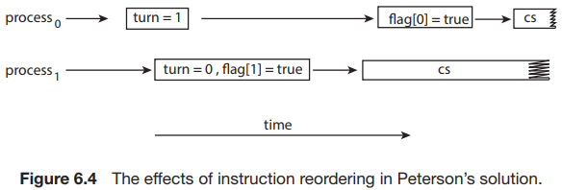
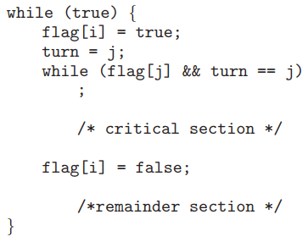
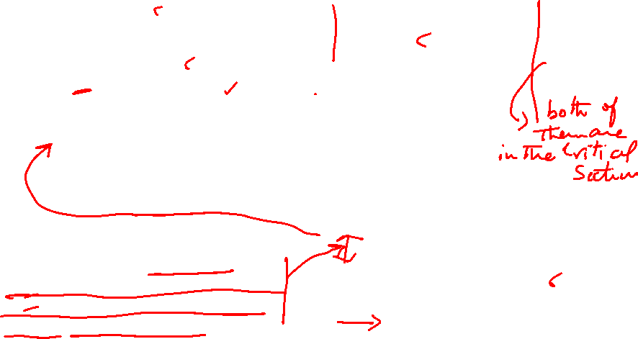
Instruction Reordering and Peterson’s Solution
Consider what happens if the assignments of the first two statements that appear in the entry section of Peterson’s solution in Figure 6.3 are reordered; it is possible that both threads may be active in their critical sections at the same time, as shown in Figure 6.4.

Slide 8
Software-based solutions are not guaranteed to work on modern computer architectures.
All processors/core need to see changes made to shared memory by threads running on other processors/cores.
Atomic operations on shared memory are needed (e.g., count++).
Uniprocessors – could disable interrupts
Currently running code would execute without preemption
Generally, too inefficient on multiprocessor systems
Operating systems using this not broadly scalable
Modern multi-core processors provide three hardware instructions to avoid these shortcomings while solving the critical-section problem. We will look at three forms of hardware support:
Memory Barriers or fences
Hardware instructions
Atomic variables

Slide 9

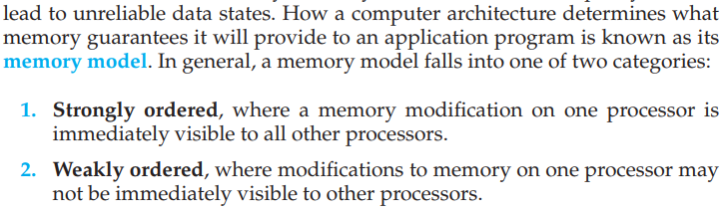
- provided by a processor

Slide 10
A memory barrier is an instruction that forces any change in memory to be propagated (made visible) to all other processors.
Therefore, even if instructions were reordered, the memory barrier ensures that the store operations are completed in memory and visible to other processors before future load or store operations are performed.
LOCK prefix: Certain instructions in the x86 instruction set can be prefixed with the LOCK prefix to create a full memory barrier. This prefix is commonly used with instructions like XCHG, CMPXCHG, ADD, INC, and DEC to enforce atomicity and memory ordering.

Slide 11
When a memory barrier instruction is encountered, the processor ensures that all preceding memory operations have completed before allowing subsequent instructions to proceed. This synchronization ensures that memory operations are observed in the expected sequence by other cores or processors in a multi-core or multi-processor system.
These instructions help maintain cache coherency and visibility across multiple processor cores or threads. They ensure that changes made to memory by one core are visible to other cores in the correct order, preventing data inconsistency issues.
These instructions are often used in conjunction with atomic operations to ensure atomicity and consistency of shared data in multi-threaded environments. They prevent race conditions and ensure that critical sections of code are executed atomically.

Slide 12
Modern Architecture Example
The expected behavior is, of course, that Thread 1 outputs the value 100 for variable x.
If due to reordering of instructions in Thread 2 so that flag is assigned true before assignment of x = 100.
Thread 1 would output 0 for variable x.
The processor may also reorder the statements issued by Thread 1 and load the variable x before loading the value of flag.
Thread 1 would output 0 for variable x even if the instructions issued by Thread 2 were not reordered.

Slide 13


Memory Barrier Example
Returning to the example of slides 6.17 - 6.18
We could add a memory barrier to the following instructions to ensure Thread 1 outputs 100:
Thread 1 now performs while (!flag) memory_barrier(); print x
Thread 2 now performs x = 100; memory_barrier(); flag = true
For Thread 1 we are guaranteed that that the value of flag is loaded before the value of x.
For Thread 2 we ensure that the assignment to x occurs before the assignment flag.

Slide 14
Hardware Instructions
Many modern computer systems provide special hardware instructions that allow us either to test and modify the content of a word or to swap the contents of two words atomically—that is, as one uninterruptible computation.
We abstract the main concepts behind these types of instructions by describing
the test and set() and
The compare and swap() instructions.
The important characteristic of these instructions are that they execute atomically.
Thus, if two test and set() instructions are executed simultaneously (each on a different core), they will be executed sequentially in some arbitrary order.

Slide 15
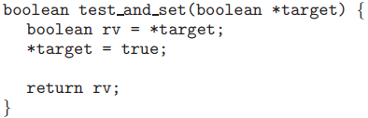
The test_and_set Instruction
Definition
Properties
Executed atomically
Returns the original value of passed parameter
Set the new value of passed parameter to true

Slide 16
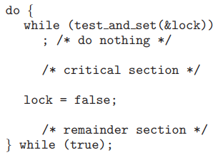
Solution Using test_and_set()
Shared Boolean variable lock, initialized to false
Solution:
Does it solve the critical-section problem?

Slide 17
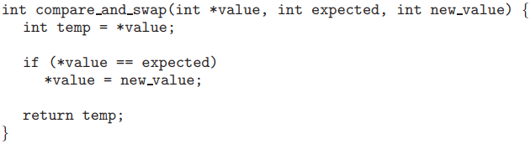
The compare_and_swap Instruction
Definition
Properties
Executed atomically
Returns the original value of passed parameter value
Set the variable value the value of the passed parameter new_value but only if *value == expected is true. That is, the swap takes place only under this condition.

Slide 18
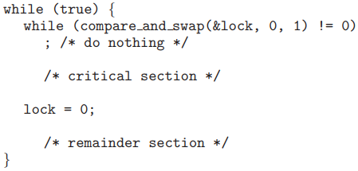

Solution using compare_and_swap
Shared integer lock initialized to 0;
Solution:
Does it solve the critical-section problem?
The first process that invokes compare and swap() will set lock to 1. It will then enter its critical section. Subsequent calls to compare and swap() will not succeed, because lock now is not equal to the expected value of 0. When a process exits its critical section, it sets lock back to 0, which allows another process to enter its critical section.

Slide 19
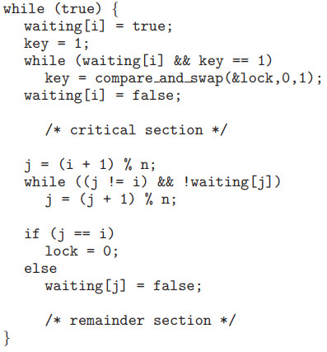

Bounded-waiting with compare-and-swap
The elements in the waiting array are initialized to false, and lock is initialized to 0.

Slide 20
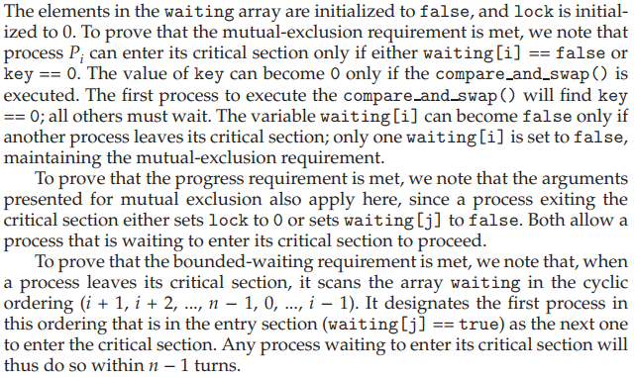
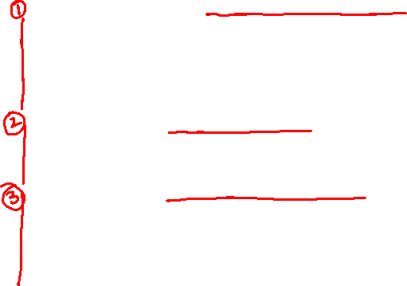
Bounded-waiting with compare-and-swap

Slide 21
Atomic Variables
Atomic variables can be used in to ensure mutual exclusion in situations where there may be a data race on a single variable while it is being updated, as when a counter is incremented.
Typically, instructions such as compare-and-swap are used as building blocks for other synchronization tools such as atomic variable that provides atomic (uninterruptible) updates on basic data types such as Integers and Booleans.
For example:
Let sequence be an atomic variable
Let increment() be operation on the atomic variable sequence
The Command:
increment(&sequence);
ensures sequence is incremented without interruption:

Slide 22
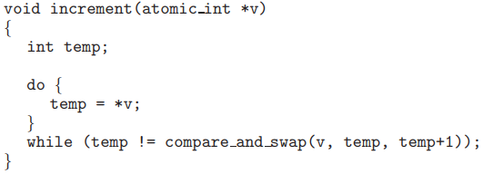
Atomic Variables
The increment() function can be implemented as follows:

Slide 23
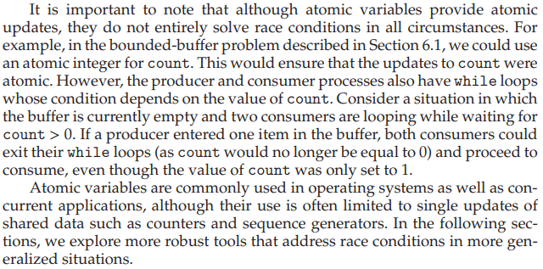

Atomic Variables - Shortcoming

Slide 24
Mutex Locks
Previous solutions are complicated and generally inaccessible to application programmers
OS designers build software tools to solve critical section problem
Simplest is mutex lock
Boolean variable indicating if lock is available or not
Protect a critical section by
First acquire() a lock
Then release() the lock
Calls to acquire() and release() must be atomic
Usually implemented via hardware atomic instructions such as compare-and-swap.
But this solution requires busy waiting
This lock therefore called a spinlock

Slide 25
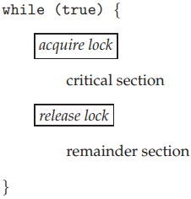
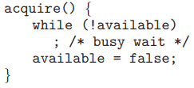

Solution to CS Problem Using Mutex Locks

Slide 26
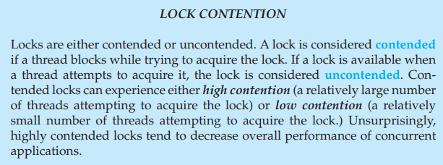
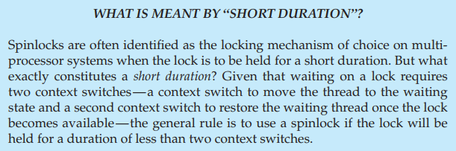

Slide 27

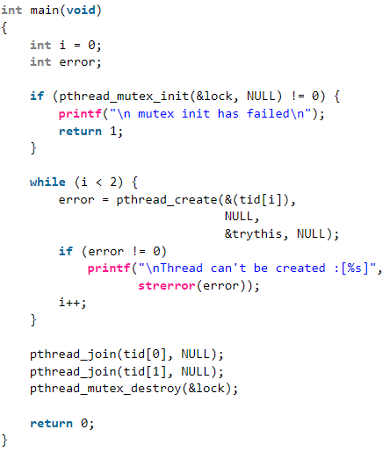
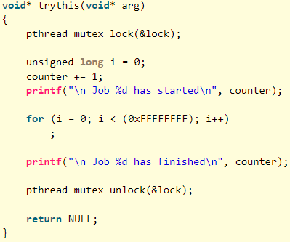
https://www.geeksforgeeks.org/mutex-lock-for-linux-thread-synchronization/

Slide 28
What is a Semaphore
A semaphore is a variable or abstract data type used to control access to a common resource by multiple processes in a concurrent system such as a multiprogramming operating system.
It has more functionality than a Mutex.

Slide 29
Semaphore
Semaphore can behave similarly to a mutex lock but provides more sophisticated ways for processes to synchronize their activities.
A semaphore S is an integer variable that, apart from initialization, is accessed only through two standard atomic operations:
wait() and signal().
Semaphores were introduced by the Dutch computer scientist Edsger Dijkstra, and such, the wait() operation was originally termed P (from the Dutch proberen, “to test”); signal() was originally called V (from verhogen, “to increment”).

Slide 30
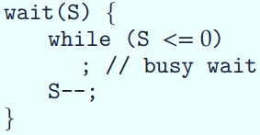

Semaphore – an integer variable with two operations
A Process/Thread Synchronization Primitive
Atomic Operations i.e. read-operation and results are done without interruptions.
Types: If if S is 0 or 1 Binary Semaphore
otherwise Counting Semaphore
Can implement a counting semaphore S as a binary semaphore
With semaphores we can solve various synchronization problems

Slide 31
Semaphore Usage Example
Solution to the CS Problem
Create a semaphore “mutex” initialized to 1
wait(mutex);
CS
signal(mutex);
Consider P₁ and P₂ that with two statements S₁ and S₂ and the requirement that S₁ to happen before S₂
Create a semaphore “synch” initialized to 0
P1:
S₁;
signal(synch);
P2:
wait(synch);
S₂;

Slide 32
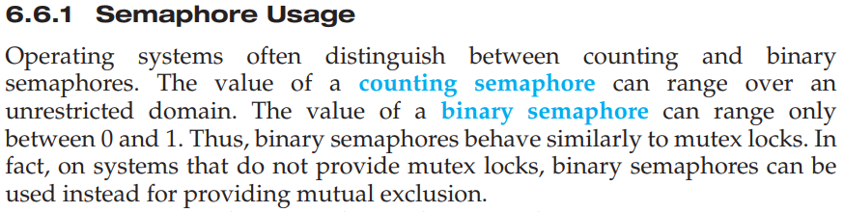
Binary Semaphore behave similar to Mutex locks and can be used instead.
Counting semaphores can be used to control access to a given resource consisting of a finite number of instances.
The semaphore is initialized to the number of resources available. Each process that wishes to use a resource performs a wait() operation on the semaphore (thereby decrementing the count). When a process releases a resource, it performs a signal() operation (incrementing the count). When the count for the semaphore goes to 0, all resources are being used. After that, processes that wish to use a resource will block until the count becomes greater than 0.

Slide 33


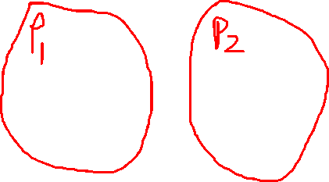
How to synchronize (serialize) statements execution in two concurrently running processes: P1 and P2?
Requirement:
Suppose we want S2 to
be executed after S1
Solution:
Use a semaphore.
Example: Use Semaphore to enforce order

Slide 34
Limitation of Semaphores
Semaphores provide a convenient and effective mechanism for process synchronization.
However, using them incorrectly can result in timing errors that are difficult to detect, since these errors happen only if particular execution sequences take place, and these sequences do not always occur.
Solution: A High-level synchronization construct— the monitor type.

Slide 35
Semaphore Implementation
Must guarantee that no two processes can execute the wait() and signal() on the same semaphore at the same time
Thus, the implementation becomes the critical section problem where the wait and signal code are placed in the critical section
Could now have busy waiting in critical section implementation
But implementation code is short
Little busy waiting if critical section rarely occupied
Note that applications may spend lots of time in critical sections and therefore this is not a good solution

Slide 36
Semaphore Implementation with no Busy waiting
With each semaphore there is an associated waiting queue
Each entry in a waiting queue has two data items:
Value (of type integer)
Pointer to next record in the list
Two operations:
block – place the process invoking the operation on the appropriate waiting queue
wakeup – remove one of processes in the waiting queue and place it in the ready queue

Slide 37
Implementation with no Busy waiting (Cont.)
Waiting queue
typedef struct {
int value;
struct process *list;
} semaphore;

Slide 38
Implementation with no Busy waiting (Cont.)
wait(semaphore *S) {
S->value--;
if (S->value < 0) { add this process to S->list;
block();
}
}
signal(semaphore *S) {
S->value++;
if (S->value <= 0) { remove a process P from S->list;
wakeup(P);
}
}

Slide 39
Problems with Semaphores
Incorrect use of semaphore operations:
signal(mutex) …. wait(mutex)
wait(mutex) … wait(mutex)
Omitting of wait (mutex) and/or signal (mutex)
These – and others – are examples of what can occur when semaphores and other synchronization tools are used incorrectly.

Slide 40
Liveness
Processes may have to wait indefinitely while trying to acquire a synchronization tool such as a mutex lock or semaphore.
Waiting indefinitely violates the progress and bounded-waiting criteria discussed at the beginning of this chapter.
Liveness refers to a set of properties that a system must satisfy to ensure processes make progress.
Indefinite waiting is an example of a liveness failure.

Slide 41
Deadlock
Deadlock – two or more processes are waiting indefinitely for an event that can be caused by only one of the waiting processes
Let S and Q be two semaphores initialized to 1
P₀ P₁
wait(S); wait(Q);
wait(Q); wait(S);
... ...
signal(S); signal(Q);
signal(Q); signal(S);
Consider if P₀ executes wait(S) and P₁ wait(Q). When P₀ executes wait(Q), it must wait until P₁ executes signal(Q)
However, P₁ is waiting until P₀ execute signal(S).
Since these signal() operations will never be executed, P₀ and P₁ are deadlocked.

Slide 42
Deadlock
Other forms of deadlock:
Starvation – indefinite blocking
A process may never be removed from the semaphore queue in which it is suspended
Priority Inversion – Scheduling problem when lower-priority process holds a lock needed by higher-priority process
Solved via priority-inheritance protocol

Slide 43
Chapter 7: Synchronization Examples

Slide 44
Outline
Explain the bounded-buffer synchronization problem
Explain the readers-writers synchronization problem
Explain and dining-philosophers synchronization problems
Describe the tools used by Linux and Windows to solve synchronization problems.
Illustrate how POSIX and Java can be used to solve process synchronization problems

Slide 45
Classical Problems of Synchronization
Classical problems used to test newly-proposed synchronization schemes
Bounded-Buffer Problem
Readers and Writers Problem
Dining-Philosophers Problem

Slide 46
Bounded-Buffer Problem
n buffers, each can hold one item
Semaphore mutex initialized to the value 1
Semaphore full initialized to the value 0
Semaphore empty initialized to the value n

Slide 47
Bounded Buffer Problem (Cont.)
The structure of the producer process
while (true) {
... /* produce an item in next_produced */
...
wait(empty);
wait(mutex);
... /* add next produced to the buffer */
...
signal(mutex);
signal(full);
}

Slide 48
Bounded Buffer Problem (Cont.)
The structure of the consumer process
while (true) {
wait(full);
wait(mutex);
... /* remove an item from buffer to next_consumed */
...
signal(mutex);
signal(empty);
... /* consume the item in next consumed */
... }

Slide 49
Readers-Writers Problem
A data set is shared among a number of concurrent processes
Readers – only read the data set; they do not perform any updates
Writers – can both read and write
Problem – allow multiple readers to read at the same time
Only one single writer can access the shared data at the same time
Several variations of how readers and writers are considered – all involve some form of priorities

Slide 50
Readers-Writers Problem (Cont.)
Shared Data
Data set
Semaphore rw_mutex initialized to 1
Semaphore mutex initialized to 1
Integer read_count initialized to 0

Slide 51
Readers-Writers Problem (Cont.)
The structure of a writer process
while (true) { wait(rw_mutex);
... /* writing is performed */
...
signal(rw_mutex);
}

Slide 52
Readers-Writers Problem (Cont.)
The structure of a reader process
while (true){ wait(mutex); read_count++; if (read_count == 1) /* first reader */
wait(rw_mutex);
signal(mutex);
... /* reading is performed */
...
wait(mutex); read_count--; if (read_count == 0) /* last reader */
signal(rw_mutex);
signal(mutex);
}

Slide 53
Readers-Writers Problem Variations
The solution in previous slide can result in a situation where a writer process never writes. It is referred to as the “First reader-writer” problem.
The “Second reader-writer” problem is a variation the first reader-writer problem that state:
Once a writer is ready to write, no “newly arrived reader” is allowed to read.
Both the first and second may result in starvation. leading to even more variations
Problem is solved on some systems by kernel providing reader-writer locks

Slide 54
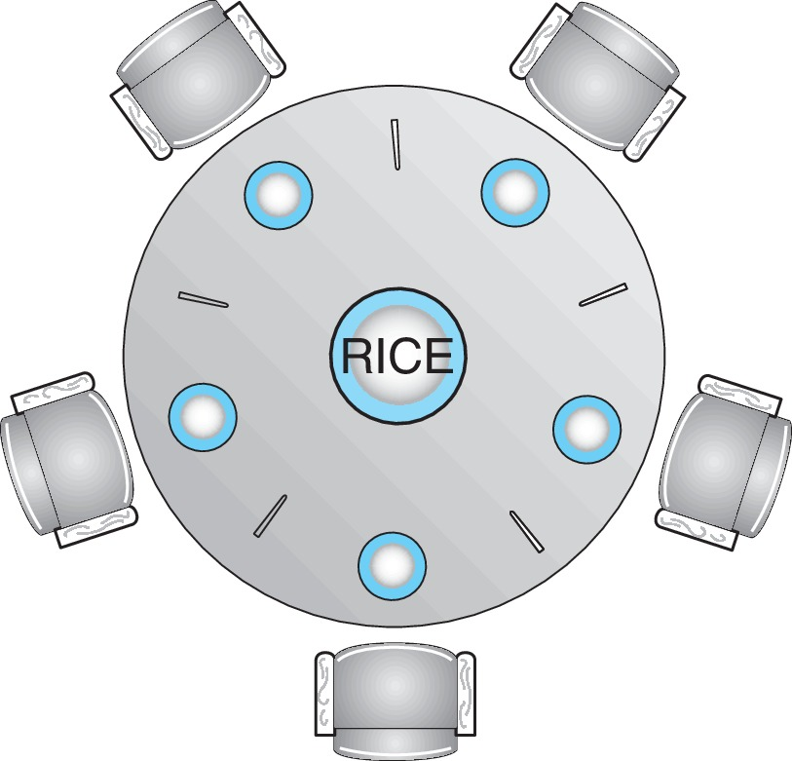
Dining-Philosophers Problem
N philosophers’ sit at a round table with a bowel of rice in the middle.
They spend their lives alternating thinking and eating.
They do not interact with their neighbors.
Occasionally try to pick up 2 chopsticks (one at a time) to eat from bowl
Need both to eat, then release both when done
In the case of 5 philosophers, the shared data
Bowl of rice (data set)
Semaphore chopstick [5] initialized to 1

Slide 55
Dining-Philosophers Problem Algorithm
Semaphore Solution
The structure of Philosopher i :
while (true){
wait (chopstick[i] );
wait (chopStick[ (i + 1) % 5] );
/* eat for awhile */
signal (chopstick[i] );
signal (chopstick[ (i + 1) % 5] );
/* think for awhile */
}
What is the problem with this algorithm?

Slide 56
Monitor Solution to Dining Philosophers
monitor DiningPhilosophers
{
enum {THINKING; HUNGRY, EATING} state [5];
condition self [5];
void pickup (int i) {
state[i] = HUNGRY;
test(i);
if (state[i] != EATING) self[i].wait;
}
void putdown (int i) {
state[i] = THINKING;
// test left and right neighbors
test((i + 4) % 5);
test((i + 1) % 5);
}

Slide 57
Solution to Dining Philosophers (Cont.)
void test (int i) {
if ((state[(i + 4) % 5] != EATING) &&
(state[i] == HUNGRY) &&
(state[(i + 1) % 5] != EATING) ) {
state[i] = EATING ;
self[i].signal () ;
}
}
initialization_code() {
for (int i = 0; i < 5; i++)
state[i] = THINKING;
}
}

Slide 58
Solution to Dining Philosophers (Cont.)
Each philosopher “i” invokes the operations pickup() and putdown() in the following sequence:
DiningPhilosophers.pickup(i);
/** EAT **/
DiningPhilosophers.putdown(i);
No deadlock, but starvation is possible

